Slide 1

SEM 8: DECENTRALIZED FINANCE
BLOCKCHAIN: CASE STUDY
THE NEXT DEFI BUBBLE- CAN WE PREDICT IT?
SANSKRUTI NAWANDER
D16ADB
38

Slide 2



INTRODUCTION
DEFI BUBBLES?
Focusing on whether it is possible to predict the next major surge.
Understanding past events, identifying early warning signs.
Analyzing market behavior are crucial for navigating this rapidly evolving space.

Slide 3
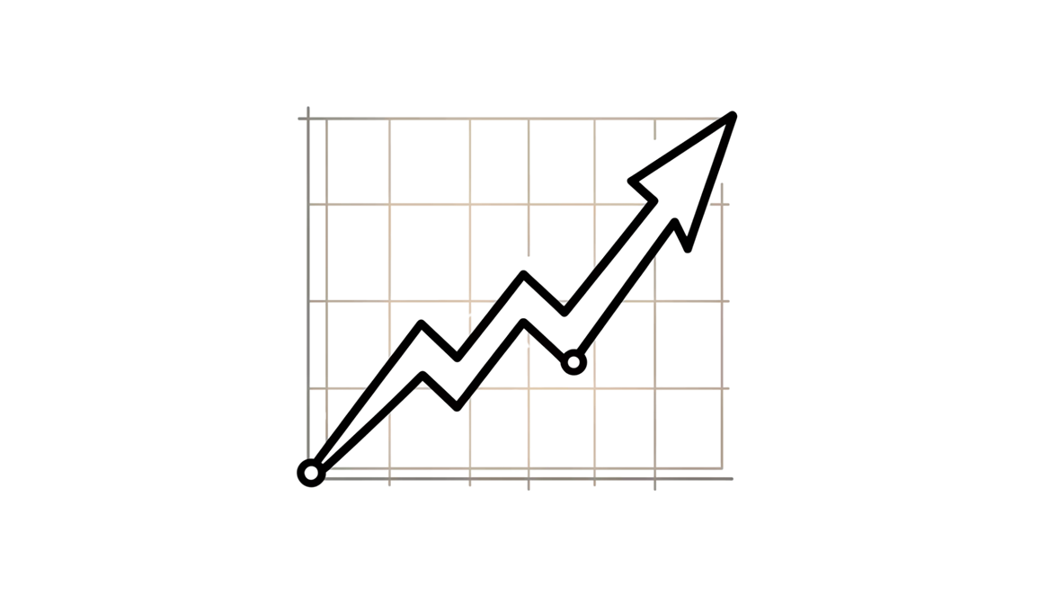
KEY INDICATORS OF BUBBLE FORMATION
Exponential growth in token prices
Unsustainable lending and borrowing rates,
Excessive leverage
Monitoring metrics like total value locked (TVL) and transaction volumes alongside market sentiment can provide early warning signals of a looming bubble.
THE 2020-2021 EXPLOSION
THE 2022 REALITY CHECK
ARE WE ON THE BRINK OF ANOTHER BUBBLE OR ENTERING A SUSTAINABLE GROWTH PHASE?

Slide 4




The 2020-2021 Explosion
DeFi's Total Value Locked (TVL) skyrocketed from under $1 billion to over $100 billion in just 18 months. Yield farming hype and liquidity mining incentives created unprecedented momentum as investors rushed to capture double and triple-digit APYs.
The 2022 Reality Check
The crash wiped out more than 70% of DeFi's market capitalization, exposing systemic vulnerabilities including smart contract exploits, unsustainable tokenomics, and excessive leverage across protocols.

Slide 5
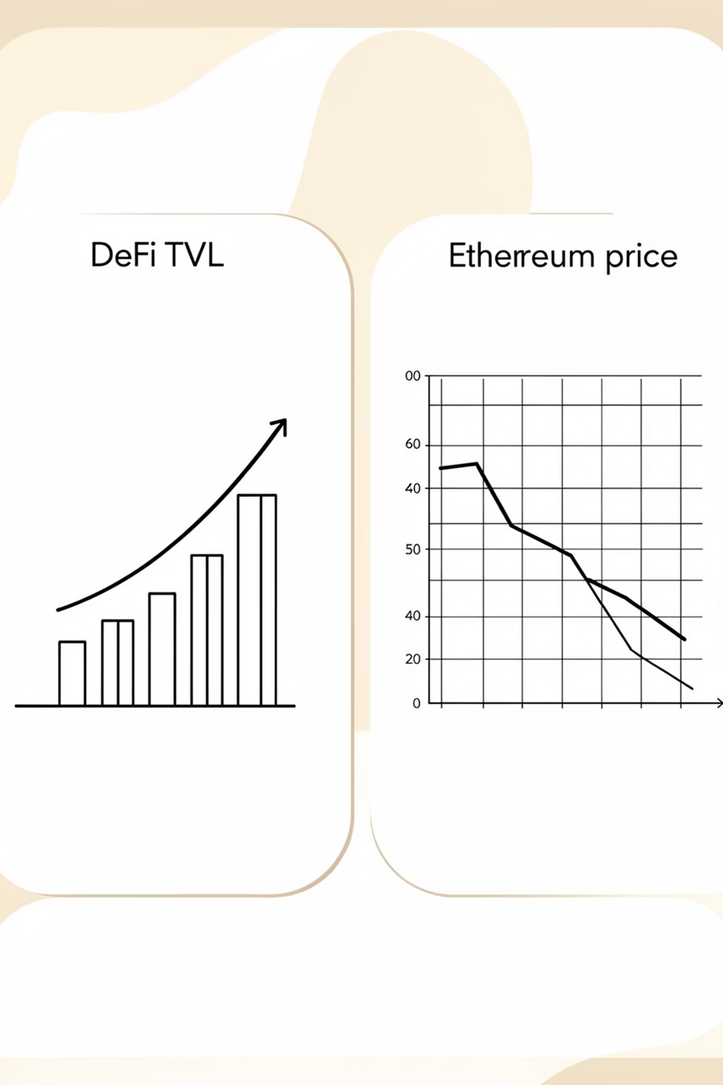
IMPACT OF BUBBLES ON THE DEFI ECOSYSTEM
DeFi bubbles often lead to severe market corrections
Significant losses for investors and undermining confidence in the ecosystem.
These cycles also expose vulnerabilities in protocols, such as liquidity risks and security flaws.
Despite short-term setbacks, bubbles can stimulate innovation and attract new participants, ultimately contributing to the ecosystem’s long-term evolution.

Slide 6

RISK MANAGEMENT AND MITIGATION STRATEGIES
Setting exposure limits
Continuous monitoring of protocol health
Employing automated alert systems and stress testing scenarios helps in mitigating potential losses.
fostering transparency and robust governance frameworks can enhance resilience against bubble-related disruptions.

Slide 7
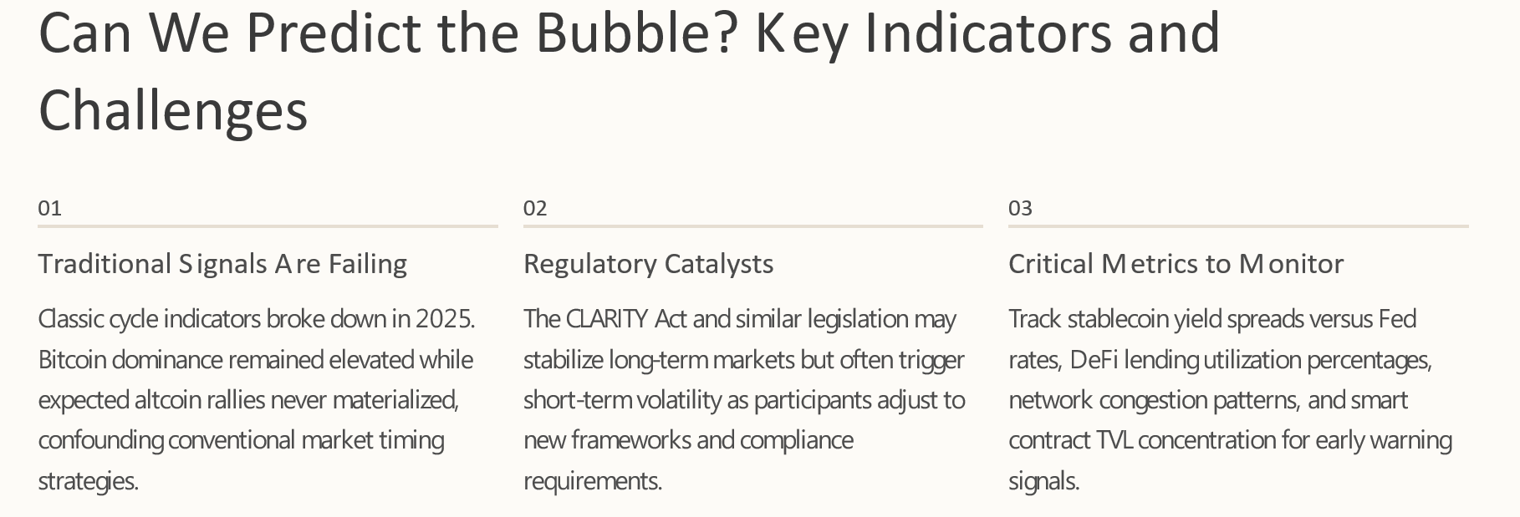
RISK MANAGEMENT AND MITIGATION STRATEGIES

Slide 8

NAVIGATING THE NEXT DEFI WAVE
The Inevitable Conclusion
Another DeFi bubble is highly probable given historical patterns, human psychology, and market dynamics. However, precise timing and magnitude remain fundamentally unpredictable.
Your Action Plan
•Prioritize protocol security audits and track records
•Demand real-world use cases beyond speculation
•Monitor regulatory developments closely
•Practice disciplined position sizing and risk management
•Maintain patience during both FOMO and panic phases

Slide 9
THANK YOU

